Slide 1
CSC D70: Compiler Optimization
Prof. Gennady Pekhimenko
University of Toronto
Winter 2023
The content of this lecture is adapted from the lectures of
Todd Mowry and Phillip Gibbons

Slide 2
CSC D70: Compiler Optimization Introduction, Logistics
Prof. Gennady Pekhimenko
University of Toronto
Winter 2023
The content of this lecture is adapted from the lectures of
Todd Mowry and Phillip Gibbons

Slide 3
Summary
Syllabus
Course Introduction, Logistics, Grading
Information Sheet
Getting to know each other
Assignments
Learning LLVM
Compiler Basics

Slide 4
Syllabus: Who Are We?

Slide 5

Gennady (Gena) Pekhimenko
Assistant Professor, Instructor
pekhimenko@cs.toronto.edu
http://www.cs.toronto.edu/~pekhimenko/
Office: BA 5232 / IC 347
PhD from Carnegie Mellon
Worked at Amazon, Microsoft Research, NVIDIA, IBM
Research interests: computer architecture, systems, machine learning, compilers, hardware acceleration
Vector Institute
EcoSystem Group

Slide 6

Bojian Zheng
PhD Student, TA
bojian@cs.toronto.edu
Office: BA 5214 D02
BSc. from UofT ECE
Research interests: computer architecture, GPUs, machine learning
Vector Institute
EcoSystem Group

Slide 7
Course Information: Where to Get?
Course Website:
https://uoft-ecosystem.github.io/CSCD70/
Announcements, Syllabus, Course Info, Lecture Notes & Videos, Tutorial Notes, Assignments
Piazza: https://piazza.com/utoronto.ca/winter2023/cscd70/home
Questions/Discussions, Syllabus, Announcements
Quercus
Emails/announcements
Your email

Slide 8
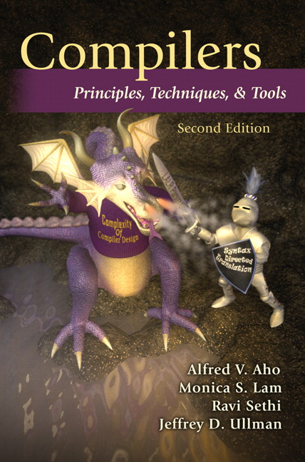
Useful Textbook

Slide 9
CSC D70: Compiler Optimization Compiler Introduction
Prof. Gennady Pekhimenko
University of Toronto
Winter 2023
The content of this lecture is adapted from the lectures of
Todd Mowry and Phillip Gibbons

Slide 10
Why Computing Matters (So Much)?

Slide 11


What is the difference between the computing industry and the paper towel industry?
Notes:
I would like to start by asking a question!

Slide 12

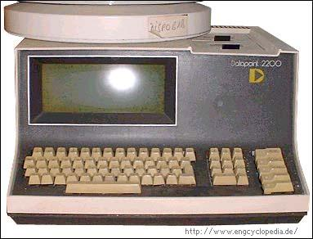




Industry of replacement
1971
2023
?
Industry of new possibilities
Notes:
The difference is we buy paper towels when we run out of them and we buy new computers because they get better!
We an industry of new possibilities and no and industry of replacement!

Slide 13
Can we continue being an industry of new possibilities?
Personalized healthcare
Virtual reality
Real-time translators

Slide 14
Moore’s Law Or, how we became an industry of new possibilities
Every 2 Years
Double the number of transistors
Build higher performance general-purpose processors
Make the transistors available to masses
Increase performance (1.8×↑)
Lower the cost of computing (1.8×↓)
Notes:
But, somebody needs to make those transistors available to the rest of the community.
All of this sounds nice and dandy, but what is the catch?

Slide 15
What is the catch? Powering the transistors without melting the chip
Moore’s Law
W
W
Notes:
The catch is powering exponentially increasing number of transistors without melting the chip down.
As this graph shows even thought we have been doubling the number of transistors every year, but we have been increasing the chip power consumption much slower and actually we have already hit the chip power budget limits.

Slide 16
Looking back Evolution of processors
Dennard scaling broke
Single-core Era
Multicore Era
3.4 GHz
3.5 GHz
740 KHz
1971
2003
2013
2004
Notes:
The general consensus was that with exploiting parallelism in the applications and increasing the number of cores we can overcome the transistor scaling trends!
We will be able to continue scaling many more generations!
There was diminishing return but if the power
We didn’t have the power to spend a
We have shown how to
With a small cores but many of them you can exploit task level parallelism!
There is enormous value in improving the performance of single cores and in performance of multicore
Our community has largely moved to multicore a larger fration of the community outgh to be investigating other paths
Right now an enormous fraction of the researh community is invested in multicore research

Slide 17

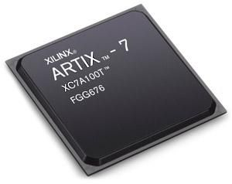
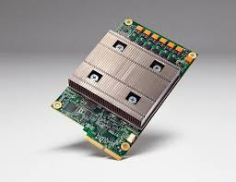
Any Solution Moving Forward?
Hardware accelerators:
GPUs
(Graphics
Processing
Units)
FPGAs
(Field Programmable
Gate Arrays)
TPUs
(Tensor
Processing
Units)

Slide 18


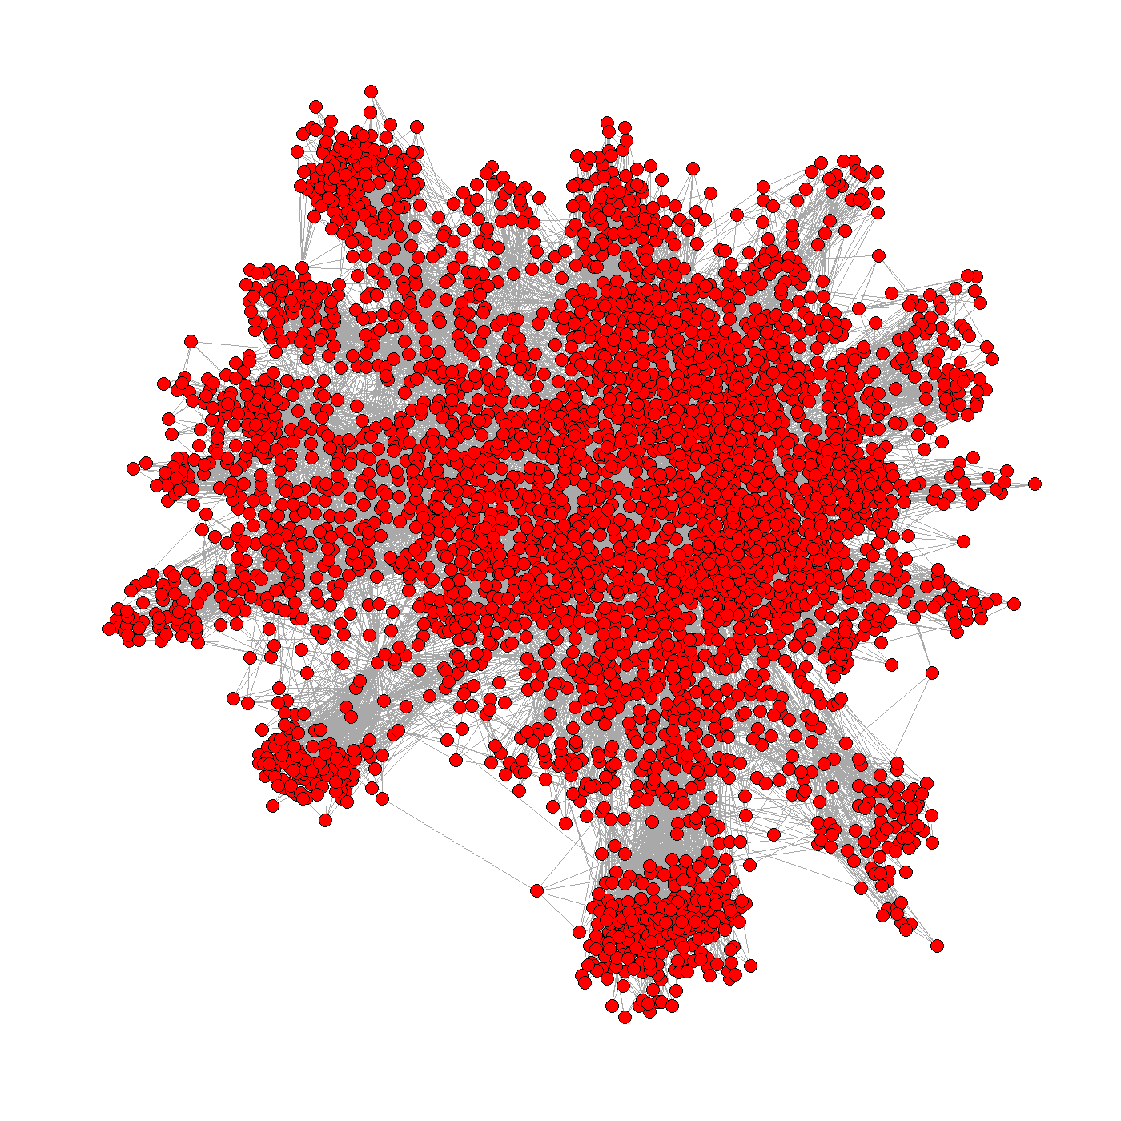











Heterogeneity and Specialization
Halide
Multicore
CPUs
FPGA
Catapult
Custom Logic
GPU
Low Power CPUs

Slide 19
Programmability versus Efficiency
General-Purpose Processors
SIMD Units
Programmability
GPUs
FPGAs
ASICs
Efficiency
We need compilers!

Slide 20
Introduction to Compilers
What would you get out of this course?
Structure of a Compiler
Optimization Example

Slide 21
What Do Compilers Do?
Translate one language into another
e.g., convert C++ into x86 object code
difficult for “natural” languages, but feasible for computer languages
Improve (i.e. “optimize”) the code
e.g., make the code run 3 times faster
or more energy efficient, more robust, etc.
driving force behind modern processor design

Slide 22
How Can the Compiler Improve Performance?
Execution time = Operation count * Machine cycles per operation
Minimize the number of operations
arithmetic operations, memory accesses
Replace expensive operations with simpler ones
e.g., replace 4-cycle multiplication with 1-cycle shift
Minimize cache misses
both data and instruction accesses
Perform work in parallel
instruction scheduling within a thread
parallel execution across multiple threads

Slide 23
What Would You Get Out of This Course?
Basic knowledge of existing compiler optimizations
Hands-on experience in constructing optimizations within a fully functional research compiler
Basic principles and theory for the development of new optimizations

Slide 24
Structure of a Compiler
x86
ARM
SPARC
MIPS
Optimizations are performed on an “intermediate form”
similar to a generic RISC instruction set
Allows easy portability to multiple source languages, target machines

Slide 25
Ingredients in a Compiler Optimization
Formulate optimization problem
Identify opportunities of optimization
applicable across many programs
affect key parts of the program (loops/recursions)
amenable to “efficient enough” algorithm
Representation
Must abstract essential details relevant to optimization

Slide 26
Ingredients in a Compiler Optimization

Slide 27
Ingredients in a Compiler Optimization
Formulate optimization problem
Identify opportunities of optimization
applicable across many programs
affect key parts of the program (loops/recursions)
amenable to “efficient enough” algorithm
Representation
Must abstract essential details relevant to optimization
Analysis
Detect when it is desirable and safe to apply transformation
Code Transformation
Experimental Evaluation (and repeat process)

Slide 28
Representation: Instructions
Three-address code
A := B op C
LHS: name of variable e.g. x, A[t] (address of A + contents of t)
RHS: value
Typical instructions
A := B op C
A := unaryop B A := B
GOTO s
IF A relop B GOTO s
CALL f
RETURN

Slide 29
Optimization Example
Bubblesort program that sorts an array A that is allocated in static storage:
an element of A requires four bytes of a byte-addressed machine
elements of A are numbered 1 through n (n is a variable)
A[j] is in location &A+4*(j-1)
FOR i := n-1 DOWNTO 1 DO
FOR j := 1 TO i DO
IF A[j]> A[j+1] THEN BEGIN temp := A[j]; A[j] := A[j+1]; A[j+1] := temp
END

Slide 30
Translated Code
i := n-1
S5: if i<1 goto s1
j := 1
s4: if j>i goto s2
t1 := j-1
t2 := 4*t1
t3 := A[t2] ;A[j]
t4 := j+1 t5 := t4-1
t6 := 4*t5
t7 := A[t6] ;A[j+1]
if t3<=t7 goto s3
t8 :=j-1
t9 := 4*t8
temp := A[t9] ;A[j]
t10 := j+1
t11:= t10-1
t12 := 4*t11
t13 := A[t12] ;A[j+1]
t14 := j-1
t15 := 4*t14
A[t15] := t13 ;A[j]:=A[j+1]
t16 := j+1
t17 := t16-1
t18 := 4*t17
A[t18]:=temp ;A[j+1]:=temp
s3: j := j+1
goto S4
S2: i := i-1
goto s5
s1:
FOR i := n-1 DOWNTO 1 DO
FOR j := 1 TO i DO
IF A[j]> A[j+1] THEN BEGIN temp := A[j]; A[j] := A[j+1]; A[j+1] := temp
END

Slide 31
Representation: a Basic Block
Basic block = a sequence of 3-address statements
only the first statement can be reached from outside the block (no branches into middle of block)
all the statements are executed consecutively if the first one is (no branches out or halts except perhaps at end of block)
We require basic blocks to be maximal
they cannot be made larger without violating the conditions
Optimizations within a basic block are local optimizations

Slide 32
Flow Graphs
Nodes: basic blocks
Edges: B_{i} -> B_{j}, iff B_{j} can follow B_{i} immediately in some execution
Either first instruction of B_{j} is target of a goto at end of B_{i}
Or, B_{j} physically follows B_{i,} which does not end in an unconditional goto.
The block led by first statement of the program is the start, or entry node.

Slide 33
Find the Basic Blocks
i := n-1
S5: if i<1 goto s1
j := 1
s4: if j>i goto s2
t1 := j-1
t2 := 4*t1
t3 := A[t2] ;A[j]
t4 := j+1 t5 := t4-1
t6 := 4*t5
t7 := A[t6] ;A[j+1]
if t3<=t7 goto s3
t8 :=j-1
t9 := 4*t8
temp := A[t9] ;A[j]
t10 := j+1
t11:= t10-1
t12 := 4*t11
t13 := A[t12] ;A[j+1]
t14 := j-1
t15 := 4*t14
A[t15] := t13 ;A[j]:=A[j+1]
t16 := j+1
t17 := t16-1
t18 := 4*t17
A[t18]:=temp ;A[j+1]:=temp
s3: j := j+1
goto S4
S2: i := i-1
goto s5
s1:

Slide 34
Basic Blocks from Example

Slide 35
Partitioning into Basic Blocks
Identify the leader of each basic block
First instruction
Any target of a jump
Any instruction immediately following a jump
Basic block starts at leader & ends at instruction immediately before a leader (or the last instruction)

Slide 36
ALSU pp. 529-531

Slide 37
Sources of Optimizations
Algorithm optimization
Algebraic optimization
A := B+0 => A := B
Local optimizations
within a basic block -- across instructions
Global optimizations
within a flow graph -- across basic blocks
Interprocedural analysis
within a program -- across procedures (flow graphs)

Slide 38
Local Optimizations
Analysis & transformation performed within a basic block
No control flow information is considered
Examples of local optimizations:
local common subexpression elimination analysis: same expression evaluated more than once in b. transformation: replace with single calculation
local constant folding or elimination analysis: expression can be evaluated at compile time transformation: replace by constant, compile-time value
dead code elimination

Slide 39
Example
i := n-1
S5: if i<1 goto s1
j := 1
s4: if j>i goto s2
t1 := j-1
t2 := 4*t1
t3 := A[t2] ;A[j]
t4 := j+1 t5 := t4-1
t6 := 4*t5
t7 := A[t6] ;A[j+1]
if t3<=t7 goto s3
t8 :=j-1
t9 := 4*t8
temp := A[t9] ;A[j]
t10 := j+1
t11:= t10-1
t12 := 4*t11
t13 := A[t12] ;A[j+1]
t14 := j-1
t15 := 4*t14
A[t15] := t13 ;A[j]:=A[j+1]
t16 := j+1
t17 := t16-1
t18 := 4*t17
A[t18]:=temp ;A[j+1]:=temp
s3: j := j+1
goto S4
S2: i := i-1
goto s5
s1:

Slide 40
Example
B1: i := n-1
B2: if i<1 goto out
B3: j := 1
B4: if j>i goto B5
B6: t1 := j-1
t2 := 4*t1
t3 := A[t2] ;A[j]
t6 := 4*j
t7 := A[t6] ;A[j+1]
if t3<=t7 goto B8
B7: t8 :=j-1
t9 := 4*t8
temp := A[t9] ;temp:=A[j]
t12 := 4*j
t13 := A[t12] ;A[j+1]
A[t9]:= t13 ;A[j]:=A[j+1]
A[t12]:=temp ;A[j+1]:=temp
B8: j := j+1
goto B4
B5: i := i-1
goto B2
out:

Slide 41
(Intraprocedural) Global Optimizations
Global versions of local optimizations
global common subexpression elimination
global constant propagation
dead code elimination
Loop optimizations
reduce code to be executed in each iteration
code motion
induction variable elimination
Other control structures
Code hoisting: eliminates copies of identical code on parallel paths in a flow graph to reduce code size.

Slide 42
Example
B7: t8 :=j-1
t9 := 4*t8
temp := A[t9] ;temp:=A[j]
t12 := 4*j
t13 := A[t12] ;A[j+1]
A[t9]:= t13 ;A[j]:=A[j+1]
A[t12]:=temp ;A[j+1]:=temp
B8: j := j+1
goto B4
B5: i := i-1
goto B2
out:
B1: i := n-1
B2: if i<1 goto out
B3: j := 1
B4: if j>i goto B5
B6: t1 := j-1
t2 := 4*t1
t3 := A[t2] ;A[j]
t6 := 4*j
t7 := A[t6] ;A[j+1]
if t3<=t7 goto B8

Slide 43
Example (After Global CSE)
B1: i := n-1
B2: if i<1 goto out
B3: j := 1
B4: if j>i goto B5
B6: t1 := j-1
t2 := 4*t1
t3 := A[t2] ;A[j]
t6 := 4*j
t7 := A[t6] ;A[j+1]
if t3<=t7 goto B8
B7: A[t2] := t7
A[t6] := t3
B8: j := j+1
goto B4
B5: i := i-1
goto B2
out:

Slide 44
Induction Variable Elimination
Intuitively
Loop indices are induction variables (counting iterations)
Linear functions of the loop indices are also induction variables (for accessing arrays)
Analysis: detection of induction variable
Optimizations
strength reduction:
replace multiplication by additions
elimination of loop index:
replace termination by tests on other induction variables

Slide 45
Example
B1: i := n-1
B2: if i<1 goto out
B3: j := 1
B4: if j>i goto B5
B6: t1 := j-1
t2 := 4*t1
t3 := A[t2] ;A[j]
t6 := 4*j
t7 := A[t6] ;A[j+1]
if t3<=t7 goto B8
B7: A[t2] := t7
A[t6] := t3
B8: j := j+1
goto B4
B5: i := i-1
goto B2
out:

Slide 46
Example (After IV Elimination)
B1: i := n-1
B2: if i<1 goto out
B3: t2 := 0
t6 := 4
B4: t19 := 4*i
if t6>t19 goto B5
B6: t3 := A[t2]
t7 := A[t6] ;A[j+1]
if t3<=t7 goto B8
B7: A[t2] := t7
A[t6] := t3
B8: t2 := t2+4
t6 := t6+4
goto B4
B5: i := i-1
goto B2
out:

Slide 47
Loop Invariant Code Motion
Analysis
a computation is done within a loop and
result of the computation is the same as long as we keep going around the loop
Transformation
move the computation outside the loop

Slide 48
Machine Dependent Optimizations
Register allocation
Instruction scheduling
Memory hierarchy optimizations
etc.

Slide 49
Local Optimizations (More Details)
Common subexpression elimination
array expressions
field access in records
access to parameters

Slide 50
Graph Abstractions
Example 1:
grammar (for bottom-up parsing):
E -> E + T | E – T | T, T -> T*F | F, F -> ( E ) | id
expression: a+a*(b-c)+(b-c)*d

Slide 51
Graph Abstractions
Example 1: an expression
a+a*(b-c)+(b-c)*d
Optimized code:
t1 = b - c
t2 = a * t1
t3 = a + t2
t4 = t1 * d
t5 = t3 + t4

Slide 52
How well do DAGs hold up across statements?
DAG – directed acyclic graph
Example 2
a = b+c;
b = a-d;
c = b+c;
d = a-d;
Is this optimized code correct?
a = b+c;
d = a-d;
c = d+c;

Slide 53
Critique of DAGs
Cause of problems
Assignment statements
Value of variable depends on TIME
How to fix problem?
build graph in order of execution
attach variable name to latest value
Final graph created is not very interesting
Key: variable->value mapping across time
loses appeal of abstraction

Slide 54
Value Number: Another Abstraction
More explicit with respect to VALUES, and TIME
each value has its own “number”
common subexpression means same value number
var2value: current map of variable to value
used to determine the value number of current expression
r1 + r2 => var2value(r1)+var2value(r2)

Slide 55
Algorithm
Data structure:
VALUES = Table of
expression //[OP, valnum1, valnum2}
var //name of variable currently holding expression
For each instruction (dst = src1 OP src2) in execution order
valnum1 = var2value(src1); valnum2 = var2value(src2);
IF [OP, valnum1, valnum2] is in VALUES
v = the index of expression
Replace instruction with CPY dst = VALUES[v].var
ELSE
Add
expression = [OP, valnum1, valnum2]
var = dst
to VALUES
v = index of new entry; tv is new temporary for v
Replace instruction with: tv = VALUES[valnum1].var OP VALUES[valnum2].var
dst = tv;
set_var2value (dst, v)

Slide 56
More Details
What are the initial values of the variables?
values at beginning of the basic block
Possible implementations:
Initialization: create “initial values” for all variables
Or dynamically create them as they are used
Implementation of VALUES and var2value: hash tables

Slide 57
Example
Assign: a->r1,b->r2,c->r3,d->r4
a = b+c; ADD t1 = r2,r3
CPY r1 = t1
b = a-d; SUB t2 = r1,r4
CPY r2 = t2
c = b+c; ADD t3 = r2,r3
CPY r3 = t3
d = a-d; SUB t4 = r1,r4
CPY r4 = t4

Slide 58
Conclusions
Comparisons of two abstractions
DAGs
Value numbering
Value numbering
VALUE: distinguish between variables and VALUES
TIME
Interpretation of instructions in order of execution
Keep dynamic state information

Slide 59
CSC D70: Compiler Optimization Introduction, Logistics
Prof. Gennady Pekhimenko
University of Toronto
Winter 2023
The content of this lecture is adapted from the lectures of
Todd Mowry and Phillip Gibbons

